Slide 1
WEB TECHNOLOGY
HTML
CSS
JS

Slide 2
WEB TECHNOLOGY
WEB
INTERNET
CLIENT
BROWSER
SERVER
WEB PAGES
WEBSITES
WEB DEVELOPMENT

Slide 3
TERMINOLOGIES
WEB : The world wide web is also called as web and it is interconnection of public websites which can be accessible through internet
INTERNET : It is system of interconnected computer networks that allows users to access and share the information
CLIENT : User
BROWSER : It is a standalone application through which we can access data with a help of internet
SERVER : It is a combination of software and hardware that receives request and response to a request over a network
WEBPAGES : It is document that is accessible by browser and it contains text,images,hyperlinks and these are also called as building blocks of websites
WEBSITES : It is collection of related or interconnected webpages

Slide 4
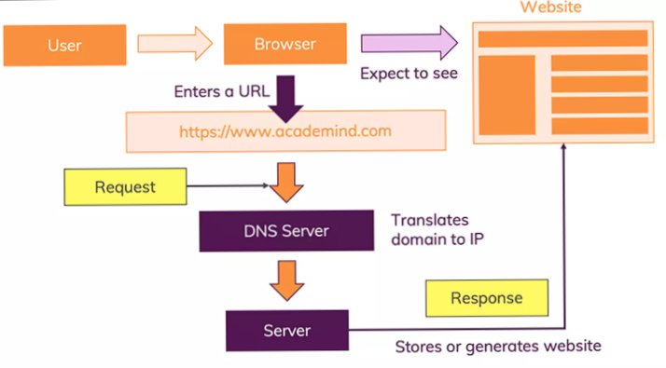
HOW WEB WORKS

Slide 5
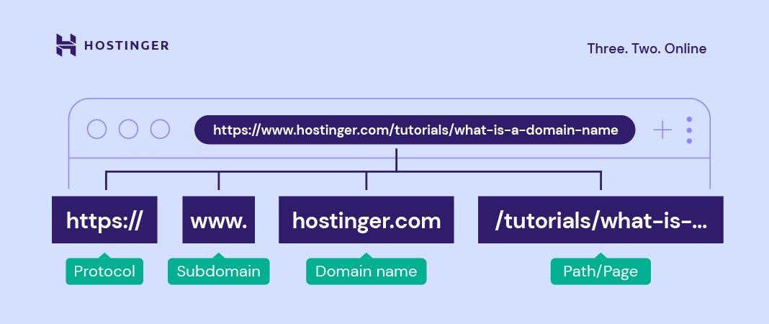

Slide 6
Difference between static and dynamic websites
Static Website | Dynamic Website
User can’t modify the content . Contents are static to all the user and same. Is has more reloading time. Most of the static websites are connected to server, Interaction will be between browser and server. Multi-page applications. Ex : w3schools | User can modify the content. Contents are dynamic to all the user and different to individual user. Comparatively less reloading time. Most of the dynamic websites follows 3 tier architecture and N TIRE ARCHITECTURE, is browser -> server -> database. Single page application. Ex : Instagram, facebook

Slide 7
html
HTML stands for Hyper Text Markup Language.
A reference / link created by developers to provide the data / information to the users which is designed by pre-defined tags and it comunicatable with browsers.
This will be first page to rendered on the browsers.
HTML is not case sensitive.
.html/.htm are the extensions for HTML.

Slide 8
HTML
HTML was introduced in 1991 by Tim Berners Lee
First version of HTML is released in 1993—html 1.0
Html 2.0----1995
Html 3.2----1997
Html 4.02----1999
Html 5.0----2014
Current version of html means now we are using html 5.0

Slide 9
Structure of html page
<!DOCTYPE html>
<html Lang="en">
<head>
<meta charset="UTF-8">
<meta http-equiv="X-UA-Compatible" content="IE=edge">
<meta name="viewport" content="width=device-width, initial-scale=1.0">
<title>JAVASCRIPT</title>
</head>
<body>
</body>
</html>

Slide 10
STRUCTURE OF HTML
<!DOCTYPE HTML>--Represents the version of html
<html>--Root element of the html page
<head>--Contains meta information about the html page
<title>--It will give the title for the webpage
<body>--It is a document’s body and it is the container for all the visible contents such as headings,paragraphs,images etc.

Slide 11
TAGS IN HTML
TAG :Tag is predefines word or keyword which is enclosed within angular braces
<html> </html>
Types of Tags
1) Paired Tags: These are the tags that will have an opening and closing tags
Ex: <p> </p>,<head> </head> etc….
2) Unpaired tags: These are the tags that will not having any closing tags and these are also called as self closing tags
Ex: </br>,<hr>,<input>,<img> etc….

Slide 12
BASIC HTML TAGS
HTML Documents:
All HTML documents must start with a document type declaration: <!DOCTYPE html>.
The HTML document itself begins with <html> and ends with </html>.
The visible part of the HTML document is between <body> and </body>.
HTML Headings:
HTML headings are defined with the <h1> to <h6> tags.
<h1> defines the most important heading. <h6> defines the least important heading
<h1>Heading 1</h1> <h2>Heading 2</h2> <h3>Heading 3</h3> <h4>Heading 4</h4> <h5>Heading 5</h5> <h6>Heading 6</h6>

Slide 13
BASIC HTML TAGS
HTML Paragraphs:
HTML paragraphs are defined with the <p> tag
HTML Links:
HTML links are defined with the <a> tag
Ex: <a href="https://www.w3schools.com">This is a link</a>
HTML Images:
HTML images are defined with the <img> tag.
The source file (src), alternative text (alt), width, and height are provided as attributes:
Ex: <img src="w3schools.jpg" alt="W3Schools.com" width="104" height="142">

Slide 14
ELEMENTS IN HTML
ELEMENTS
An HTML element is defined by a start tag, some content, and an end tag.
Tags along with the content is known as element
Ex: <h1>Hello World</h1>
BLOCK LEVEL ELEMENTS : It will take entire width of the browser and these are starts from new line
Ex:<div>,<table>,<form>,<nav><nav>
INLINE ELEMENTS : It will take only content width
These are starts from the same line means next to each other
Ex:<span>,<b>,<i>,<u>

Slide 15
ATTRIBUTE IN HTML
ATTRIBUTES:
HTML attributes provide additional information to HTML tags.
All HTML elements can have attributes
Attributes are always specified in the start tag/opening tag
Attributes usually come in name/value pairs like: name="value“.
Values of an attributes are case sensitive
Core Attributes:
Id
Title
Class
Style

Slide 16
Core attributes
Id : It is used to target a particular element uniquely.
Class : The class attribute specifies one or more classnames for an element
Title : The title attribute gives a suggested title for the element. It is used to give tooltip for the element.
Style : It specifies an inline style for an element.

Slide 17
HTML Formatting tags
Formatting elements were designed to display special types of text:
<b> - Bold text
<strong> - Important text
<i> - Italic text
<em> - Emphasized text
<mark> - Marked text
<ins> - Inserted text
<sub> - Subscript text
<sup> - Superscript text

Slide 18
Sectioning Elements/semantic elements
What are Semantic Elements?
A semantic element clearly describes its meaning to both the browser and the developer.
Examples of semantic elements: <form>, <table>, and <article> - Clearly defines its content.
Examples of non-semantic elements: <div> and <span> - Tells nothing about its content.

Slide 19
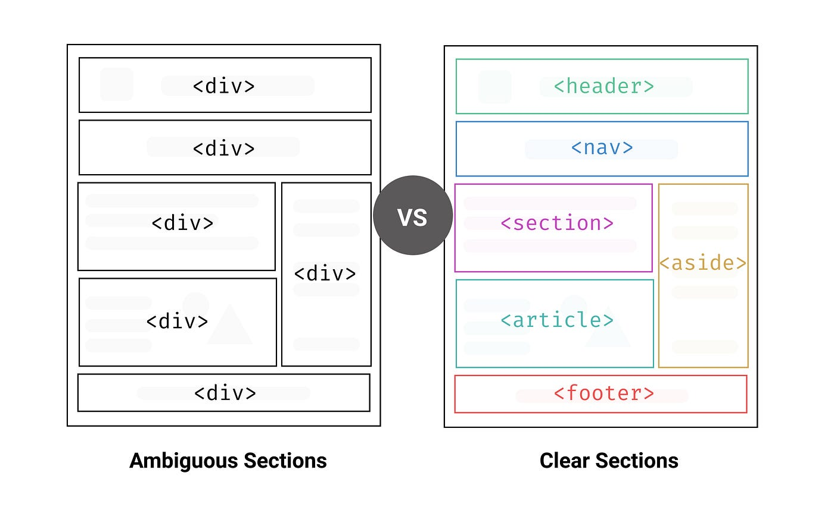
SEMANTIC TAGS IN HTML
Semantic elements represents their meaning to both the browser and developer.
All semantic elements are block level elements.

Slide 20
Semantic elements in html
HDAMNSTAFF
H →HEADER
D →DETAILS
A →ASIDE
M →MAIN
N →NAV
S →SUMMARY AND SECTION
T →TABLE
A →ARTICLE
F →FIGURE
F →FIGCAPTION/FOOTER

Slide 21
HTML Lists
Unordered HTML List:
An unordered list starts with the <ul> tag. Each list item starts with the <li> tag.
The list items will be marked with bullets (small black circles) by default
Attributes
Type : square,circle,none
Ordered HTML List:
An ordered list starts with the <ol> tag. Each list item starts with the <li> tag.
The list items will be marked with numbers by default
Attributes:
Type : numbers,alphabets(lower,upper),roman(lower,upper)
Start: number
reverse
Description Lists:
A description list is a list of terms, with a description of each term.
The <dl> tag defines the description list, the <dt> tag defines the term (name), and the <dd> tag describes each term
Nested Lists:
List inside another list is called as nested list.

Slide 22
TABLES IN HTML
HTML Tables: A table in HTML consists of table cells inside rows and columns.
<table> tag is used to create a table in html
Table Headers: Sometimes you want your cells to be table header cells. In those cases use the <th> tag
Table Rows: Each table row starts with a <tr> and ends with a </tr> tag.
Table Cells: Each table cell is defined by a <td> and a </td> tag.

Slide 23
Table-Attributes
Border: It is used give the border to table.(<table>)
Cell Padding: It is the space between the cell edges and the cell content. (<table>)
By default the padding is set to 0
Cell Spacing: It is the space between each cell.
By default the space is set to 2 pixels. (<table>)
Colspan : It is used to merge multiple columns.(<td>)
Rowspan : It is used to merge multiple rows.(<td>)

Slide 24
IMAGES
<img> tag is used to insert an image in webpage
Image is inline element
Attributes
src : It is an attribute of img tag, Inside this we will pass the path of the image.
alt: It is used give the alternative name for the image
When the image is not displaying on webpage this alternative name will be displayed
height: It is used give the height for the image
width : It is used give the width for the image

Slide 25
Absolute Url v/s Relative Url
Absolute URL | Relative URL
a full web address in the href attribute. <p><a href="https://www.w3.org/">W3C</a></p> | A local link (a link to a page within the same website) is specified with a relative URL (without the "https://www" part): <p><a href="html_images.asp">HTML Images</a></p>

Slide 26
Anchor and Hyper Links
The <a> tag defines a hyperlink, which is used to link from one page to another.
The most important attribute of the <a> element is the href(hyper reference) attribute, which indicates the link's destination.
By default, links will appear as follows in all browsers:
An unvisited link is underlined and blue
A visited link is underlined and purple
An active link is underlined and red

Slide 27
Html anchor tag
Text as a Link
To use an text as a link, just write the text inside the <a> tag with href attribute
Image as a Link
To use an image as a link, just put the <img> tag inside the <a> tag:
Button as a Link
To use an button as a link, just put the <button> tag inside the <a> tag:

Slide 28
HTML Links - The target Attribute
By default, the linked page will be displayed in the current browser window. To change this, you must specify another attribute that is target for the link.
The target attribute specifies where to open the linked document.
The target attribute can have one of the following values:
→ _self - Default. Opens the document in the same window/tab as it was clicked
→ _blank - Opens the document in a new window or tab
→ _parent - Opens the document in the parent frame
→ _top - Opens the document in the full body of the window

Slide 30
HTML Forms
The <form> Element
The HTML <form> element is used to create an HTML form for user input
The <form> element is a container for different types of input elements, such as: text fields, checkboxes, radio buttons, submit buttons, etc.
The <input> Element
The HTML <input> element is the most used form element.
An <input> element can be displayed in many ways, depending on the type attribute.
Ex:
<input type="text">Displays a single-line text input field
<input type="radio">Displays a radio button(for selecting one of many choices)
<input type="checkbox">Displays checkbox(for selecting zero or more of many choices)
<input type="button">Displays a clickable button
<input type="submit">Displays a submit button(for submitting the form)

Slide 31
HTML Form Elements
Tag | Description
<form> | Defines an HTML form for user input
<input> | Defines an input control
<textarea> | Defines a multiline input control (text area)
<label> | Defines a label for an <input> element
<fieldset> | Groups related elements in a form
<legend> | Defines a caption for a <fieldset> element
<select> | Defines a drop-down list
<optgroup> | Defines a group of related options in a drop-down list
<option> | Defines an option in a drop-down list
<button> | Defines a clickable button
<datalist> | Specifies a list of pre-defined options for input controls

Slide 32
Attributes
<form>
Action : It defines action to be performed when the form is submitted.
Method : It specifies the http method to be used when submitting the form data.(get-Not secured and post-Secured)
<label>
for: It is used to connect label and input text field.
<input>
Id : It is used to connect label and input text field and the value passed in the id attribute should be same as the value passed in the for attribute.
Name : The value of name attributes acts like container, The form values with name attribute will sent to a server when submitting the form.
Type : It represents the type of data

Slide 33
Form Validation Attributes
1) Value : The input value attribute specifies an initial value for an input field
2) Read only : The input read only attribute specifies that an input field is read-only.
3) Disabled: The input disabled attribute specifies that an input field should be disabled.
A disabled input field is unusable and un-clickable.
4) Size: The input size attribute specifies the visible width, in characters, of an input field.
The default value for size is 20.
Note: The size attribute works with the following input types: text, search, tel, url, email, and password.

Slide 34
Validation attributes
5) Maxlength : The input maxlength attribute specifies the maximum number of characters allowed in an input field.
6) Min & Max: The input min and max attributes specify the minimum and maximum values for an input field.
7) Placeholder: The input placeholder attribute specifies a short hint that describes the expected value of an input field (a sample value or a short description of the expected format).
8) Required: The input required attribute specifies that an input field must be filled out before submitting the form.

Slide 35
Validation attributes
9) Autofocus: The input autofocus attribute specifies that an input field should automatically get focus when the page loads.
10) Height & Width: The input height and width attributes specify the height and width of an <input type="image"> element.
11) List: The input list attribute refers to a <datalist> element that contains pre-defined options for an <input> element.

Slide 36
Html media
Multimedia on the web is sound, music, videos, movies.
HTML media consist of audio,video,maps and qrcode.
Audio:
<audio> tag is used to embed the audio into our web page.
The content which is written in side <audio></audio> will not displayed on the webpage
Attributes of audio tag:
Src : we will pass path of audio.
Controls : The controls attribute adds audio controls, like play, pause, and volume .
Muted : It will mute the audio when you open your file with browser
Autoplay: It will play the audio automatically when you open your file with browser.
Loop : The audio will start over again , every time it is finished.

Slide 37
Media tags
Video :
<video> tag is used to embed the video into our web page.
The content which is written in side <video></video> will not displayed on the webpage
Attributes of audio tag:
Src : we will pass path of video.
Controls : The controls attribute adds video controls, like play, pause, and volume .
Muted : It will mute the video when you open your file with browser
Autoplay: It will play the video automatically when you open your file with browser.
Loop : The video will start over again , every time it is finished.

Slide 38
Media tags
iframe:
<iframe> tag is used to embedded the another document within the current HTML document.
An HTML iframe is used to display a web page within a web page.
The HTML <iframe> tag specifies an inline frame.
Height and width attributes are used to specify the height and width of th iframe
Title attribute is used to give the title for the iframe

Slide 39
Maps and qrcode
We can insert a qr code to our webpages using <img> tag.
cht : qr (chat type)
chs : width x height (height and width)
chl : chat link (path or link)
Syntax
Root URL: https://chart.googleapis.com/chart?

